Slide 1
MLDS HW0
TAs
ntu.mldsta@gmail.com

Slide 2
Outline
- Task Description
- 加簽規定
- Kaggle Rules
- Q&A

Slide 3
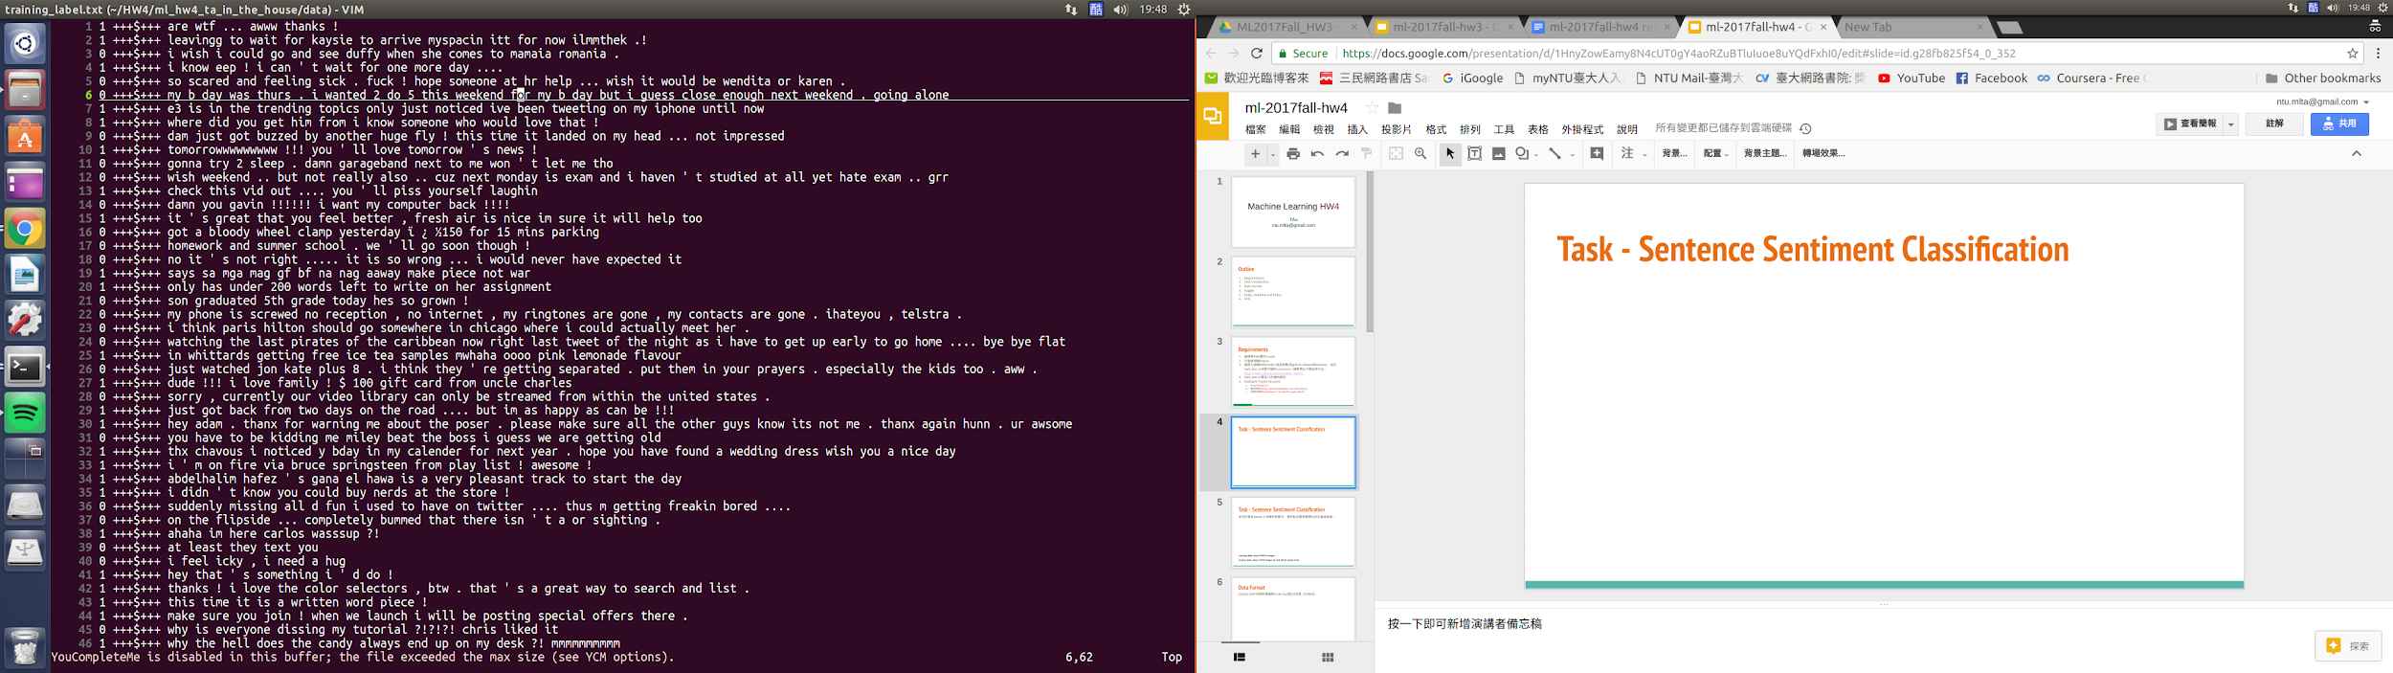
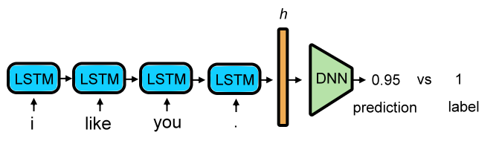
Task Description - Text Sentiment Classification
There is no limitation on the method you use to solve the task as long as it’s ML based.

Slide 4
Task Description - Dataset
本次作業為twitter上收集到的推文，每則推文都會被標注為正面或負面，如：
除了有label的data以外，我們還額外提供了120萬筆左右沒有label的data
labeled training data ：20萬
unlabeled training data ：120萬
testing data ：20萬（No private testing set）
1：正面
0：負面

Slide 5
Task Description - Data format
Three files provided on kaggle
training_label.csv
labeled training data with each line being <sentence label> +++$+++ <sentence>
training_noabel.csv
unlabeled training data with each line being <sentence>
testing_data.csv
testing data for submission with header id,text and each of the following line being <sentence id>,<sentence>

Slide 6
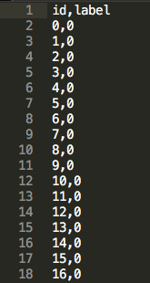
Task Description - Submission format
Submissions should follow the format in sampleSubmission.csv

Slide 7
加簽規定
To join the class, you will have to...
參加Kaggle並且通過門檻
大學部學生：通過Simple Baseline 研究生以上：通過Strong Baseline
如果太多同學符合資格將按照通過Baseline的時間順序加簽, Leaderboard 最後排名成績並不影響加簽順序
TA會在2018/3/6 23:59:59 之前將符合加簽資格同學的授權碼寄到學校信箱(學號@ntu.edu.tw)
沒有成功加簽的同學也會收到信件，如果有問題可以直接回覆給TA詢問。

Slide 8
Kaggle Rules
Kaggle link : https://www.kaggle.com/t/73e2d5edd30f4608a17a84130cb91969
One person per team. Team name must be [your student ID] with lowercase letter. e.g. b03902034
Deadline : 2018/3/4 23:59:59 (GMT+8)
10 submissions allowed per day
Please do NOT upload prediction again once you’ve passed the threshold.
Code submission is not required.
Only the public leaderboard will be use for hw0.

Slide 9
Q&A
Email TA if you have any question.
ntu.mldsta@gmail.com

